Slide 1
IoT Data Management
Presented by: Advithi D Samanvitha A

Slide 2
Agenda
01
02
03
04
Introduction
Problem Statement
Solution Approaches
Comparitive Analysis

Slide 3
Introduction
IoT sensor data plays a crucial role in revolutionizing the retail landscape and redefining the customer experience.
From gathering and cleaning diverse data sources to extracting actionable insights for decision support, the journey of IoT data management is marked by the need for robust strategies in data collection, processing, analysis, and storage.
This work explores how the combination of IoT and data science techniques can enhance personalized customer experiences and improve marketing strategies.

Slide 4
Problem Statement
Retail environments are equipped with multiple onboard sensors that measure various parameters. By applying data science techniques to the sensor data various applications can emerge to enhance personalized customer experiences and marketing strategies. What kinds of applications could be developed in these areas?

Slide 5
Solution Approaches
Location-Based Sensing Approach:
IoT and Data Integration: GPS trackers, beacons, and geofencing to track customer movements. Aggregate large volumes of location data and harmonize it with other customer data using ETL processes and integration platforms.
Data Management and Security: Implement scalable databases and data aggregation techniques to manage data volume while preserving essential information. Data privacy can be ensured with encryption, access controls, and GDPR and CCPA regulations.
Data Science: Stream processing frameworks can be utilized for real-time updates and association rule mining techniques can be used to uncover purchase patterns. Location-based recommendations and clustering algorithms can be implemented for personalized offers and segmentation of customers for enhanced customer experiences.

Slide 6
2. Enhancing Accessibility by In-Store Navigation and Product Identification:
IoT Sensors: Ultrasonic sensors connected to microcontrollers can be mounted to the trolleys to detect obstacles, they can be integrated with RFID and Analog Playback Recorder to help them navigate in the store and identify products.
Data Processing, Integration, Storage, and Management: Edge computing can be implemented for real-time data processing and reduce latency. IoT sensor data with customer profiles are integrated using scalable cloud databases while ensuring data governance and security.
Data science: NLP and computer vision play crucial roles in converting semi-structured or unstructured data into structured formats. Data science techniques can be used to analyze customer data, predict buying patterns, and personalize recommendations. Location-based models can assist with in-store navigation.

Slide 7
3. Sensor-Centric Approach:
Sensors: Temperature sensors and smart cameras can be used in retail stores for customer comfort and capture real-time customer behavior. Which can be integrated with NAS systems. Additionally, ESLs provide customers with real-time updates on product prices and promotions.
Data Management Methods: Edge computing can be utilized for real-time data processing. Implement cloud-based databases for data storage. Sensors can collect data from the environment and send it to the IoT hub which then transfers the data to the NAS system.
Data Science: IoT sensor data is analyzed, predictive analytics on buying patterns enhances customer satisfaction by providing customized promotions. Data science techniques can be implemented to provide personalized product recommendations and discounts. The performance of these models can be monitored using A/B testing.

Slide 8
Comparison of performance of solutions
Aspect | Location-Based Sensing | In-Store Navigation | Sensor-Centric
Response Time | High (Real-time tracking) | Intermediate (Edge computing) | Intermediate (Edge computing)
Scalability | High (Cloud-based) | High (Cloud/Edge) | High (Cloud-based)
Accuracy | High (Precise location data) | High (NLP, computer vision) | High (Accurate sensor data)
Customer Engagement | High (Personalized offers) | Intermediate (Better navigation) | High (Real-time updates)
Implementation | Intermediate (Complex integration) | Intermediate (Sensor integration) | Intermediate (Sensor setup)
Cost Efficiency | Intermediate (Wi-Fi based Geofencing, integration costs) | Intermediate (Sensor costs) | Intermediate (Sensor costs)

Slide 9
References
S. Shekhawat, "Use of AI and IoT to make Retail Smarter," 2022 3rd International Informatics and Software Engineering Conference (IISEC), Ankara, Turkey, 2022, pp. 1-5, doi: 10.1109/IISEC56263.2022.9998202.
Hossain, Md & Chisty, Nur & Amin, Ruhul. (2021). Role of Internet of Things (IoT) in Retail Business and Enabling Smart Retailing Experiences. Asian Business Review. 11. 75-80. 10.18034/abr.v11i2.579
Margaje, S.C., & Rasal, V. (2021). A Review on Smart Retail Shop Using Artificial Intelligence (AI) and Internet of Things (IoT). International Research Journal of Modernization in Engineering Technology and Science, 03(11), 1-10. Retrieved from www.irjmets.com.
Gonçalves, Luisa & Patrício, Lia & Teixeira, Jorge Grenha & Wünderlich, Nancy. (2020). Understanding the customer experience with smart services. Journal of Service Management. 31. 723 744. 10.1108/JOSM-11-2019-0349.
M. Ma, P. Wang and C. -H. Chu, "Data Management for Internet of Things: Challenges, Approaches and Opportunities," 2013 IEEE International Conference on Green Computing and Communications and IEEE Internet of Things and IEEE Cyber, Physical and Social Computing, Beijing, China, 2013, pp. 1144-1151, doi: 10.1109/GreenCom-iThings-CPSCom.2013.199.
Eyada, Mahmoud & Saber, Walaa & El Genidy, Mohammed & Amer, Fathy. (2020). Performance Evaluation of IoT Data Management Using MongoDB Versus MySQL Databases in Different Cloud Environments. IEEE Access. 8. 110656-110668.
Abu-Elkheir, Mervat, Mohammad Hayajneh, and Najah Abu Ali. 2013. "Data Management for the Internet of Things: Design Primitives and Solution" Sensors 13, no. 11: 15582-15612. https://doi.org/10.3390/s131115582.
Zuva, Keneilwe, and Tranos Zuva. "Tracking of customers using geofencing technology." International Journal of Scientific Research & Engineering Technology (IJSET) 13 (2019): 10-15.
N. Adkar, A. Talele, C. Mundhe and A. Gunjal, "Bluetooth Beacon Applications in Retail Market," 2018 International Conference On Advances in Communication and Computing Technology (ICACCT), Sangamner, India, 2018, pp. 225-229, doi: 10.1109/ICACCT.2018.8529470.
Y. Okamoto, K. Arai, T. Kobayashi, T. Fujihashi, T. Watanabe and S. Saruwatari, "A NAS Integrated File System for On-site IoT Data Storage," 2020 IEEE International Conference on Pervasive Computing and Communications Workshops (PerCom Workshops), Austin, TX, USA, 2020, pp. 1-7, doi: 10.1109/PerComWorkshops48775.2020.9156143.

Slide 10
Thank You
Happy to answer any questions

Slide 11
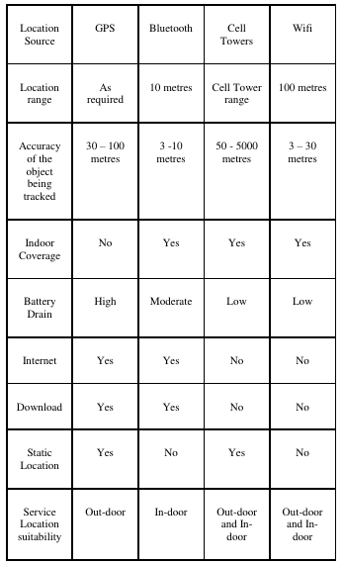

Slide 12
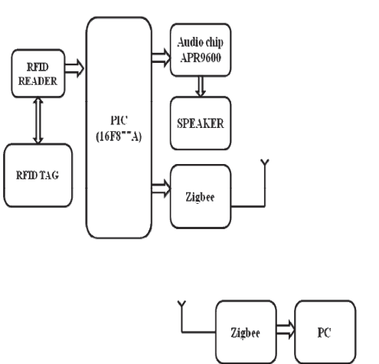

Slide 13
Comparison of solutions
Aspect | Location-Based Sensing Approach | Enhancing Accessibility by In-Store Navigation and Product Identification | Sensor-Centric Approach | Best
Data Management | Cloud databases, GDPR/CCPA compliance | Edge computing, cloud databases | Edge computing, cloud storage | Tie: All robust
Data Science | Real-time updates, rule mining, clustering | NLP, computer vision, recommendations | Predictive analytics, filtering | Location-Based Sensing
Customer Benefits | Personalized offers, enhanced experience | Improved navigation, product ID | Comfort, real-time price updates | Depends on priority
Best For | Marketing, customer insights | Accessibility, navigation | Comfort, engagement | Location-Based Sensing

